Slide 1
Games of chance

Slide 2
Games of Chance
Dice games: backgammon, Yahtzee, craps, …
Card games: poker, blackjack, …
Is there a fundamental difference between the nondeterminism in chess-playing vs. the nondeterminism in a dice roll?

Slide 3
MAX
CHANCE
MIN
CHANCE
MAX

Slide 4
Expected Values
The utility of a MAX/MIN node in the game tree is the max/min of the utility values of its successors
The expected utility of a CHANCE node is the expected value of the utility values of its successors
ExpectedValue(s) = Σ_{s’∈SUCC(s)} ExpectedValue(s’) P(s’)
CHANCE nodes
Compare to
MinimaxValue(s) = max _{s’∈SUCC(s)} MinimaxValue(s’)
MAX nodes
MinimaxValue(s) = min _{s’∈SUCC(s)} MinimaxValue(s’)
MIN nodes

Slide 5
Generalizing Minimax Values
Utilities can be continuous numerical values, rather than +1, 0, -1
Allows maximizing the amount of “points” (e.g., $) rewarded instead of just achieving a win
Rewards associated with terminal states
Costs can be associated with certain decisions at non-terminal states (e.g., placing a bet)

Slide 6
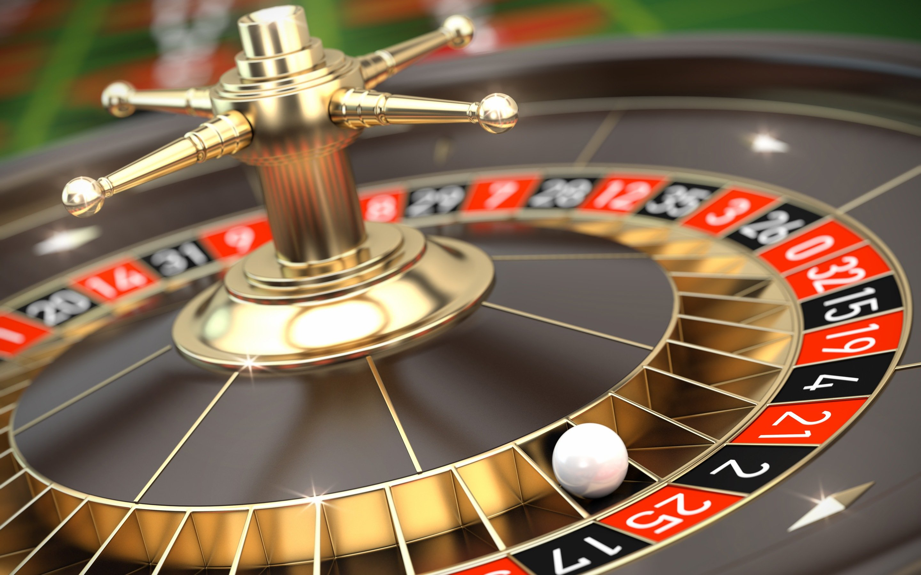
Roulette
18 red, 18 black, 2 green spots (American version)
Bet on color: bet $1, get $2 back.
Bet on a number: bet $1, get $35 back
http://www.siwallpaperhd.com/wp-content/uploads/2016/07/gambling_roulette_wallpaper_full_hd.jpg

Slide 7
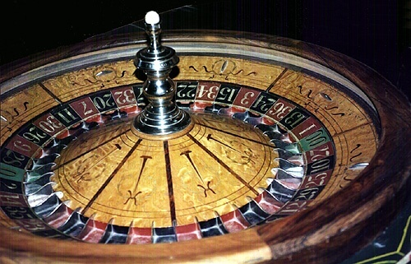
Roulette
No bet
“Game tree” only has depth 2
Place a bet
Observe the roulette wheel
Bet: Red, $5
Chance node
Probabilities
18/38
20/38
Red
Not red
+10
0

Slide 8
Chance Node Backup
Expected value:
For k children, with backed up values v₁,…,v_{k}
Chance node value = p₁ * v₁ + p₂ * v₂ + … + p_{k} * v_{k}
Bet: Red, $5
Value:
18/38 * 10 + 20/38 * 0
≈ 4.74
Chance node
Probabilities
18/38
20/38
Red
Not red
+10
0

Slide 9
MAX/Chance Nodes
Max should pick the action leading to the node with the highest value
MAX
Bet: Red, $5
Bet: 17, $5
4.74
4.74 ≈ 180/38
Chance
18/38
20/38
1/38
37/38
Red
Not red
17
Not 17
+10
0
+180
0

Slide 10
Adversarial Games of Chance
E.g., Backgammon
MAX nodes, MIN nodes, CHANCE nodes
Expectiminimax search
Backup step:
MAX = maximum of children
CHANCE = average of children
MIN = minimum of children
CHANCE = average of children
4 levels of the game tree separate each of MAX’s turns!
Evaluation function? Pruning?

Slide 11
Larger example
MAX
3
3 -1.2
CHANCE
½ ½ 0.4 0.6
MIN
2 4 0 -2
2 4 7 4 6 0 5 -2

Slide 12
Expectiminimax
Pruning is less possible
As depth increases, probability of reaching a given node shrinks
Complexity O((bn)^{h}),
n chance nodes
TDGammon uses depth-2 search + very good Eval ≈ world-champion level (plays backgammon)

Slide 13
Expectiminimax evaluation function
Evaluation functions quickly return an estimate for a node’s true value.
For minimax, evaluation function scale doesn’t matter (only order matters)
We just want better states to have higher evaluations (get the ordering right)
We call this insensitivity to monotonic transformations
For expectimax, we need magnitudes to be meaningful

Slide 14
Card Games
Blackjack (6-deck), video poker: similar to coin-flipping game
But in many card games, need to keep track of history of dealt cards in state because it affects future probabilities
One-deck blackjack
Bridge
Poker

Slide 15
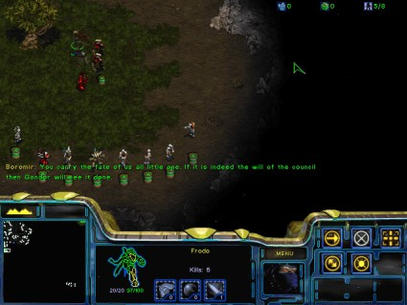
Partially Observable Games
Partial observability
Don’t see entire state (e.g., other players’ hands)
“Fog of war”
Examples:
Kriegspiel (see R&N)
Battleship
Stratego

